Slide 1
Site Plan
Imaginary Company name: Little London Commerce
Why Little London Commerce?
The company name was inspired by the meaning of my city called “Londrina”, which means “Little London”.

Slide 2
Site Purpose:
The purpose of the “Little London Commerce” is to increase the awareness of the people from all around the world, about the commerce of the city. It will also show some as a bonus some tourist places and events of the city.
Doing so, we will be able to show that, Londrina have a big potential in a lot of different market fields of our world, which will raise interest of other companies to give a shot on the market potential of Londrina.
We assure you, that investing in Londrina will only bring profit for your company!

Slide 3
Domain:
The chosen domain is: littlelondoncommerce.com

Slide 4
Target Audience:
The target audience that we are looking for are mainly adults looking for ways to integrate their business into Londrina, or people who wants a good place to start a new or expand their business.
In Londrina this is possible, since Londrina is a very known point of commerce and also development.
Londrina has showed to Brazil, that it’s worth to work in its city, and that the future of Londrina is one of the most exciting things about the city.

Slide 5
Personas

Slide 6
Persona-1:
Name: Mario
Company: SuperStock
History:
I came from a small city nearby, and there me and my friend decided to open a company. We called it SuperStock.
We bought some land, and built a few warehouses, then we started to rent it to other companies nearby, but because it was located in a small city, it rarely could catch the attention of big industries around. We were desperate for recognition!
One day me and my friend were looking for more possible clients, and that's when we found www.LittleLondonCommerce.com.
With it we discovered a lot of new clients, and after a while, we dicided to open a SuperStock in Londrina, and that was litteraly one of the best decisions we ever made.

Slide 7
Persona-2:
Name: Nicole
Company: GraphcalLife
History:
Before entering GraphcalLife, I was working as a free lancer, seeking like crazy for clients all around Paraná, the state that I was born.
After years of working in the area of design graphics, I decided that I should change, and find a company for me to work on, that's when a friend of mine told me about.
Londrina, and it's commerce, so I decided to do a little search of the city called Londrina. That's when I found www.LittleLondonCommerce.com, and there, I could find a lot of different companies that works in the same area as I'm looking for.
That's when I found GraphcalLife, and got more knowledge of the design graphics.

Slide 8
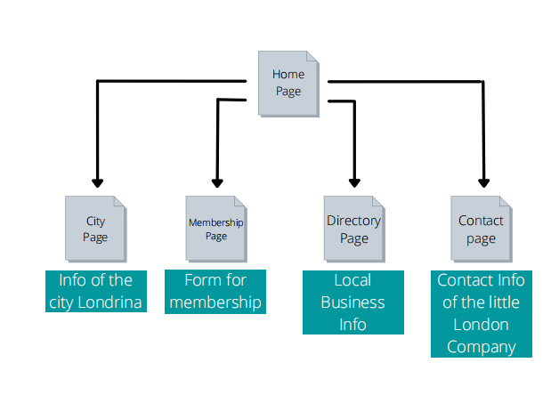
Site Map

Slide 9

Color scheme

Slide 10
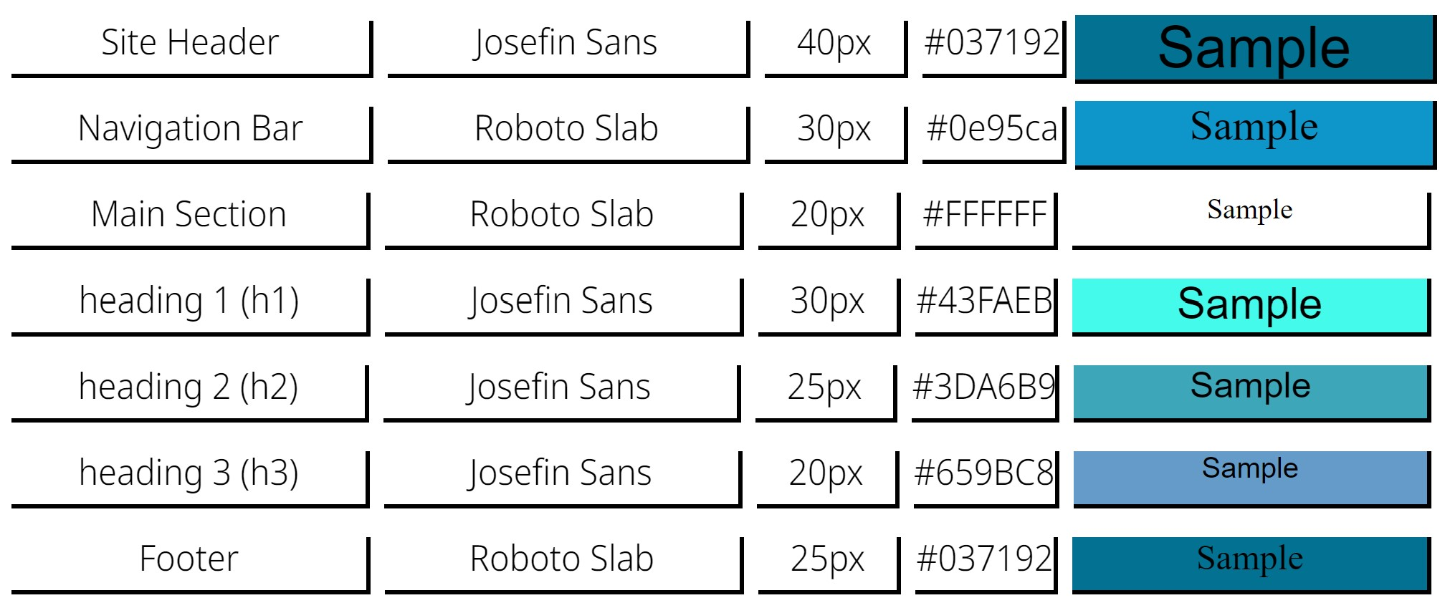
Typography

Slide 11
Wireframes for home page

Slide 12
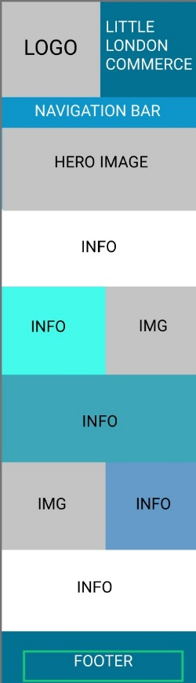
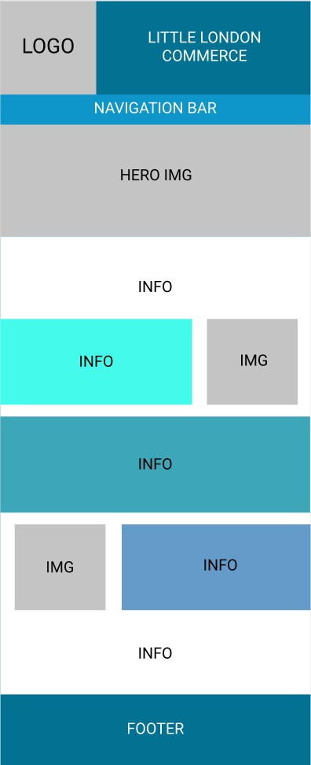
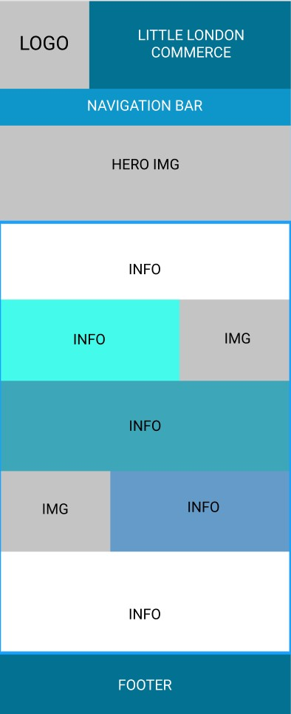
SMALL
MEDIUM
LARGE

